Slide 1
Crowdsourcing
JDI OPEN – 3 FEBRUARY 2020

Slide 2

"The use of internet services to host research opportunities that draw from a large and diverse population of participants."
Palmer & Strickland (2016)

Slide 3

Crowdsourcing platform
Task

Slide 4
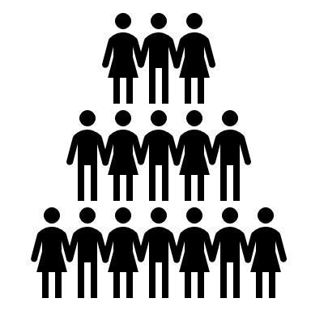
Why crowdsource?
Convenient sampling
Access to a ‘different’ population
Genuine participants (usually)

Slide 5
Features
Prolific Academic
Ethical rewards (at least £5 an hour)
Pre-screening
Representative and niche samples
Failed participations

Slide 6
Our experiences
Over 2,000 responses in about 2-3 hours (Caitlin)
Feedback and messages of concern
High quality data (e.g. free text)
‘Trusting’ sample

Slide 7
Limitations and concerns
Sampling bias
’Professional’ study participants and fatigue
Ethical concerns
Bots (mostly on Amazon Turk), liars, cheaters, and slackers

Slide 8
Examples
‘I just wish I had the money behind me to be able to relax and do something I enjoy more than this.’
‘being unwell isnt have a good impact on my mood. feeling lonely and like i need a friend’
‘I have recently lost my job and I don't know where to turn. I'm now on prolific doing as many assignments as I can to try and earn a little bit of money.’

Slide 9
Tips and tricks
Piloting
Large-scale studies and access
Running in batches
Compulsory items and missing data
Payment
Attention checks

Slide 10

Open science
Pros
Replicable sampling
Open participant pool data (Prolific)
Easy preregistration
Cons
Worsening publication bias?
Affordability

Slide 11
Further reading
‘The Internet Is Enabling a New Kind of Poorly Paid Hell’ https://www.theatlantic.com/business/archive/2018/01/amazon-mechanical-turk/551192/?source=post_page---------------------------
Beyond the Turk: Alternative platforms for crowdsourcing behavioral research https://www.sciencedirect.com/science/article/pii/S0022103116303201
A Beginner's Guide to Crowdsourcing https://www.apa.org/science/about/psa/2016/06/changing-minds
The Perils of Mturk, Part 1: Fuel to the Publication Bias Fire? https://thenewstatistics.com/itns/2018/05/02/the-perils-of-mturk-part-1-fuel-to-the-publication-bias-fire/
Prolific’s Best Practice Guide https://researcher-help.prolific.co/hc/en-gb/categories/360000850653-Prolific-s-Best-Practice-Guide
How to improve your data quality (catch bots etc.) https://blog.prolific.co/how-to-improve-your-data-quality/

